Slide 1
Kubernetes Core Concepts: Pods, ReplicaSets, Deployments
Week 5

Slide 2
Agenda
Pods vs Containers
Pods Use Cases
Deploying Pods
ReplicaSets
Deploying ReplicaSet
Using kubectl run
Using YAML file

Slide 3
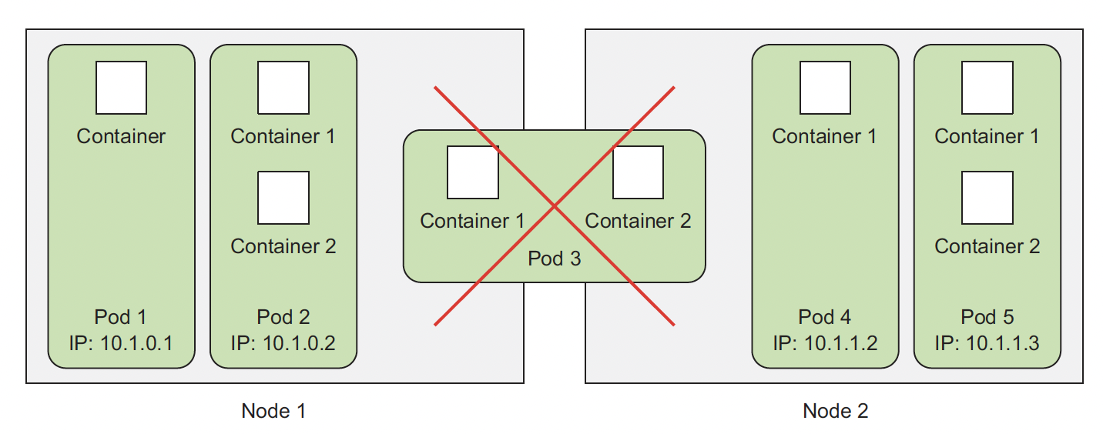
Pods vs Containers
Pods are co-located groups of containers
Pods (and not containers) represent the minimal deployment unit in K8s
Containers in a pods are scheduled, started and terminated as one unit
Containers in a pod share the same network, processes and can share the same filesystem

Slide 4
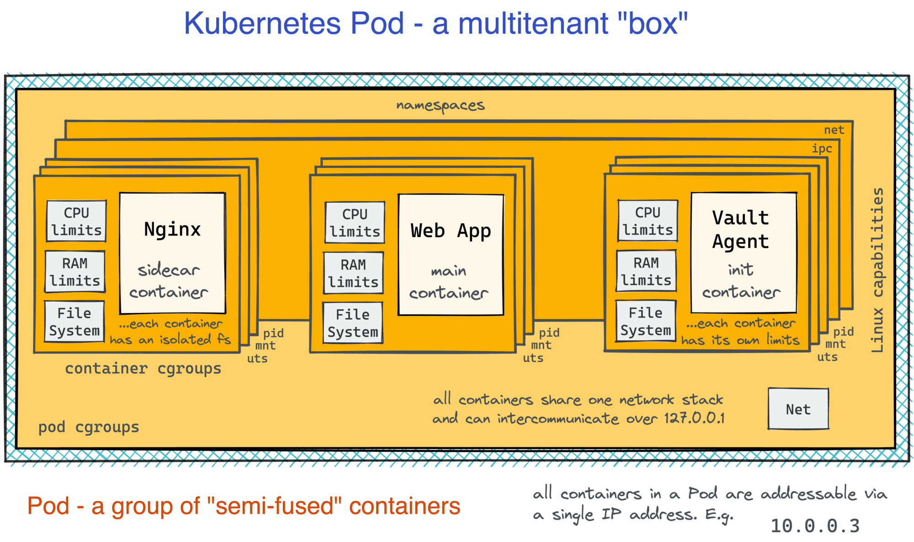
Pods – The best of VMs and Containers World
Notes:
https://iximiuz.com/en/posts/kubernetes-vs-virtual-machines/

Slide 5
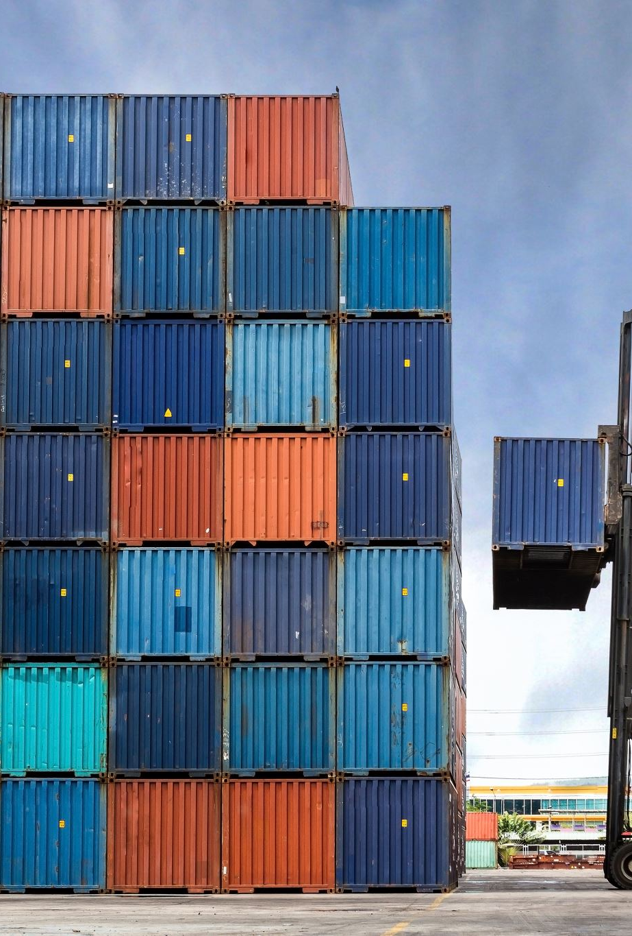
Pods Use Cases
Containers are designed to run a single process – what if we need to run multiple related processes the way we run them on a VM
Pods are logical hosts used to run tightly coupled application components
Running multiple processes in a container adds a lot of complexity
Running related processes as multiple isolated containers is not trivial
Keeping track which containers are related
Start and stop them simultaneously
Scale them simultaneously
Pod provides the best of both worlds
Containers in the pod share Linux namespaces (UTS, Network IPC); docker containers have their own individual namespaces
Containers in the pod are somewhat isolated – each container in the pod has its own filesystem
Containers share the same loopback interface (127.0.0.1)
Notes:
For example, you’d have to include a mechanism for automatically
restarting individual processes if they crash. Also, all those processes would
log to the same standard output, so you’d have a hard time figuring out what process
logged what.
Therefore, you need to run each process in its own container. That’s how Docker
and Kubernetes are meant to be used.
Restarting, synchronizing, allocating resources to processes will be your responsibility if you run multiple processes in a containers
A pod of containers allows you to run closely related processes together and provide
them with (almost) the same environment as if they were all running in a single
container, while keeping them somewhat isolated.

Slide 6
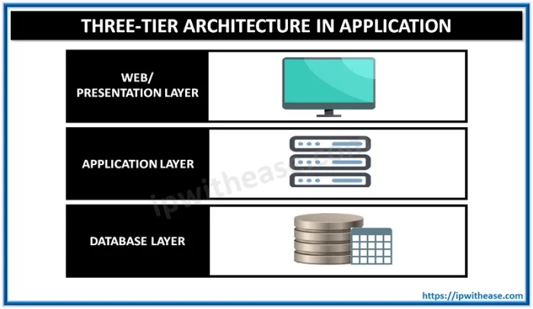
Splitting Application into Multiple Pods
Do you think a multi-tier application consisting of a frontend web server, application server and a backend database should be configured as a single pod or as two pods?
Notes:
Reasons to split into individual components:
- to use all the resources so individual pods can be scheduled on different machines
- to allow individual scaling
- to support individual deployment

Slide 7
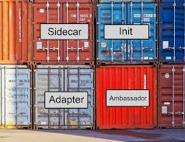
Running Multiple Containers in a Pod
Do they need to be run together or can they run on different hosts?
Do they represent a single whole or are they independent components?
Must they be scaled together or individually?

Slide 8
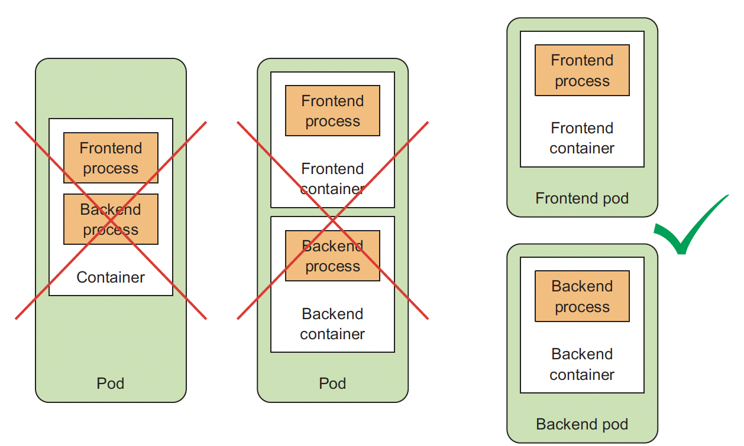
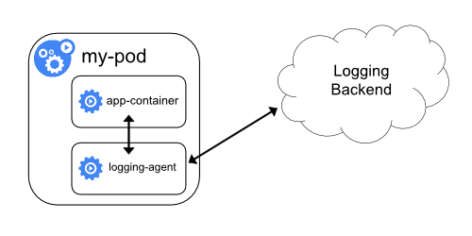
Collocating Processes in the Pod
Main process and a side car pattern
- user input validation sidecar
- logging rotation sidecar
- content enrichment sidecar

Slide 9
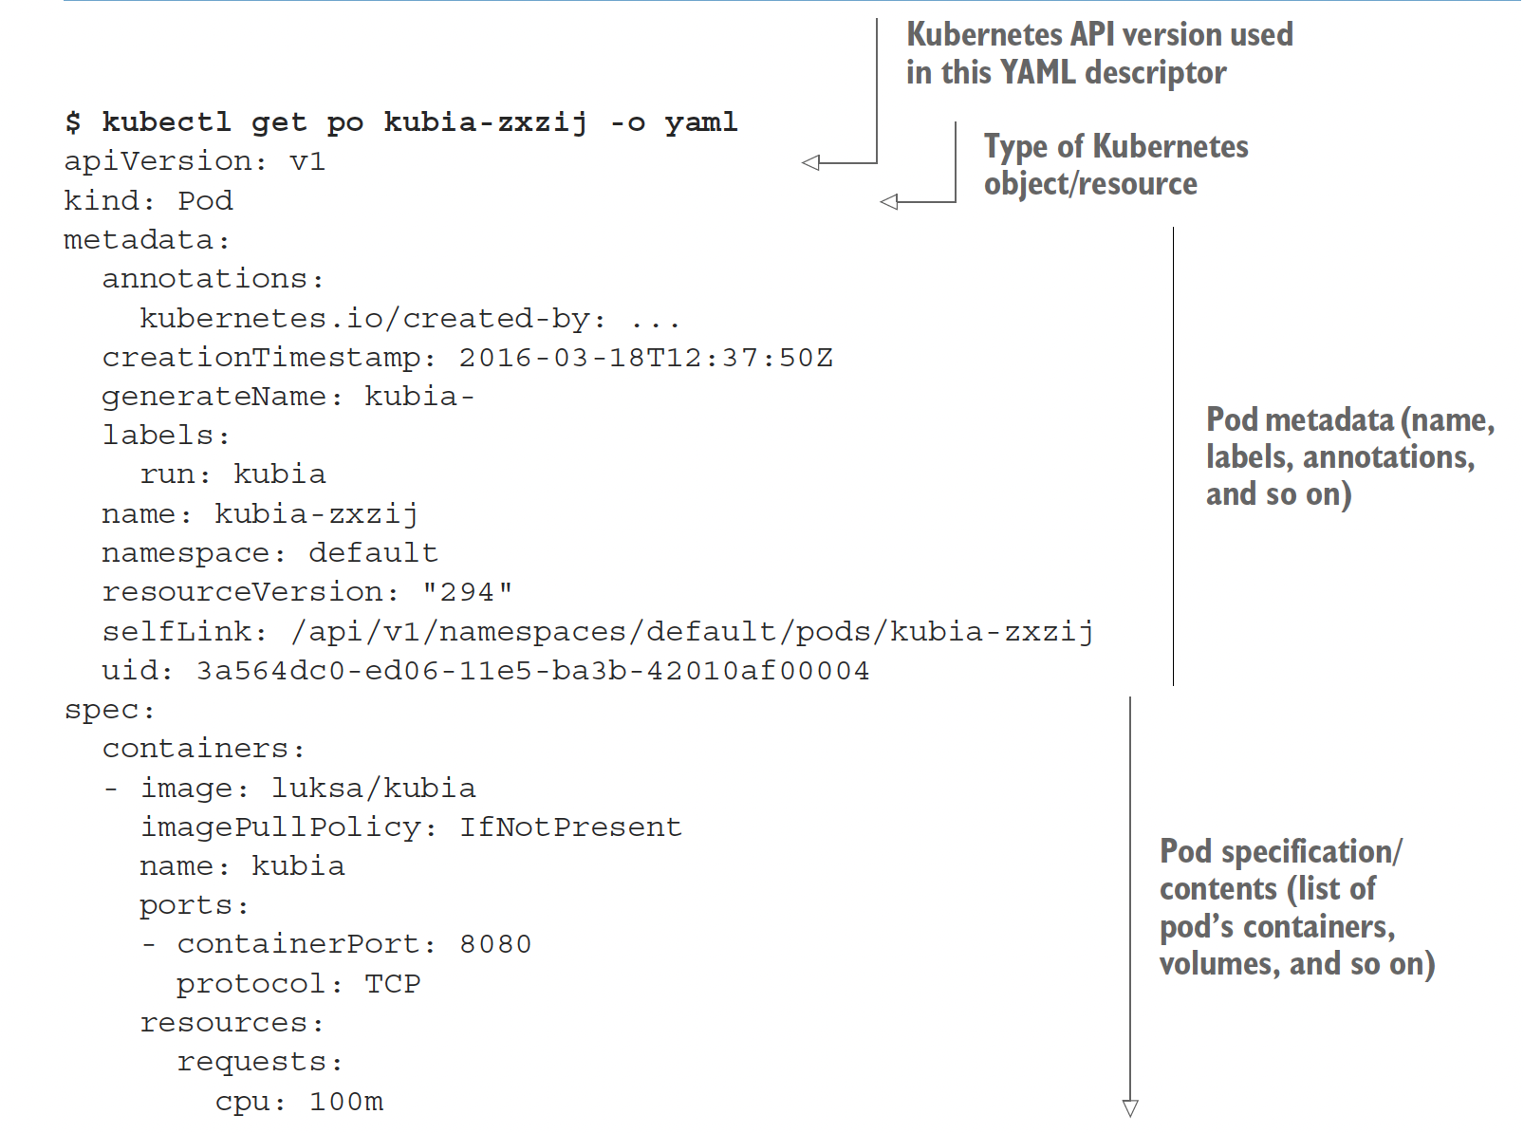
Introducing Pod Descriptor
Metadata includes the name, namespace, labels, and other information about the pod.
Spec contains the actual description of the pod’s contents, such as the pod’s containers, volumes, and other data. Pod specification/contents (list of pod’s containers, volumes, and so on)

Slide 10
YAML – Pod Descriptor

Slide 11
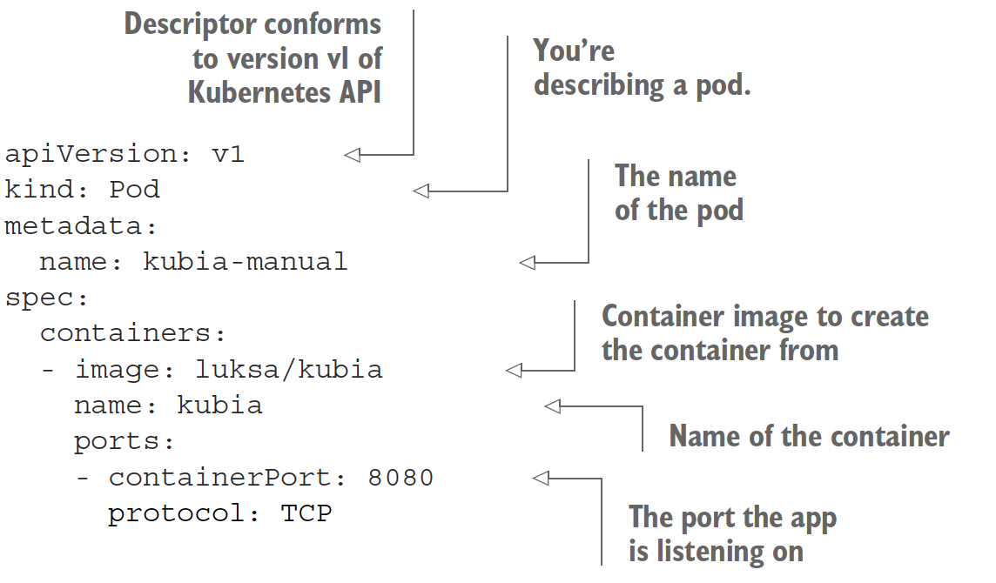
Creating Pods from Descriptor
Notes:
Specifying container port in Pod descriptor is purely informational.
The port is available based on the app running in the container and is not available externally unless explicitly exposed.

Slide 12
Pods: Summary
Can have one or multiple containers
Runs on a single node
(Pod cannot "straddle" multiple nodes)
Pods cannot be moved (e.g. in case of node outage)
Pods cannot be scaled horizontally (except by manually creating more Pods)

Slide 13
Pods: Summary Continued
Pod is not a process; it's an environment for containers
it cannot be "restarted"
it cannot "crash"
The containers in a Pod can crash
They may or may not get restarted
(depending on Pod's restart policy)
If all containers exit successfully, the Pod ends in "Succeeded" phase
If some containers fail and don't get restarted, the Pod ends in "Failed" phase

Slide 14
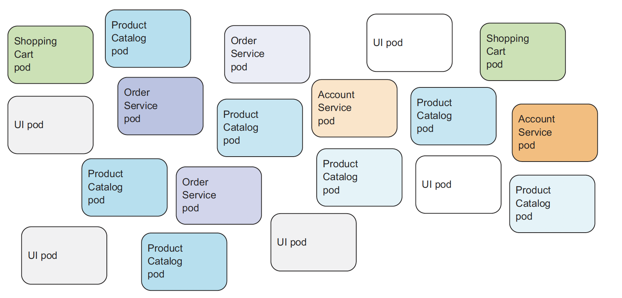
Organizing K8s Objects with Labels
Notes:
When running real world applications we will have many app components (pod) running simultaneously.
We need a way to organize them into relevant groups to scale, roll out new versions.
Organizing pods and all other Kubernetes objects is done through labels.

Slide 15
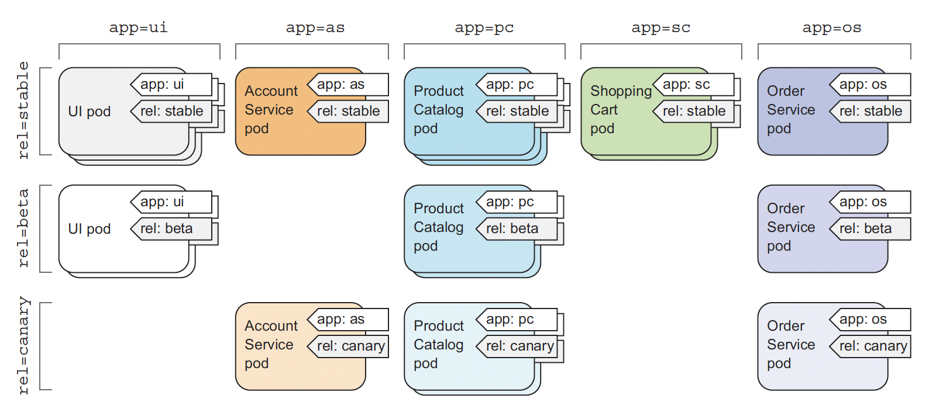
Labels in K8s
Arbitrary key-value pairs added to resource manifest
Used by label selectors
Added to metadata section of the manifest
Example
App
Release

Slide 16
Scaling Pods
Task: We need to create multiple containers of the same type
We can run the commands below multiple times
kubectl run kubia –image luksa/kubia
kubectl create –f kubia-descriptor.yaml
Is it the right way to scale?

Slide 17
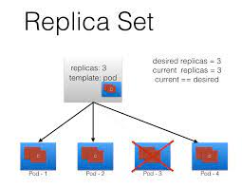
Scaling Pods - ReplicaSet
Set of identical (replicated) Pods
Defined by a pod template + number of desired replicas
If there are not enough Pods, the Replica Set creates more (e.g. in case of node outage; or simply when scaling up)
If there are too many Pods, the Replica Set deletes some (e.g. if a node was disconnected and comes back; or when scaling down)
We can scale up/down a Replica Set
we update the manifest of the Replica Set
as a consequence, the Replica Set controller creates/deletes Pods

Slide 18
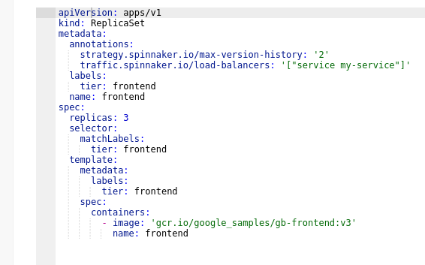
Creating ReplicaSet from Descriptor

Slide 19

Pods -> ReplicaSets -> Deployments
Replica Sets control identical Pods
Deployments are used to roll out different Pods (different image, command, environment variables, ...)
When we update a Deployment with a new Pod definition:
a new Replica Set is created with the new Pod definition
that new Replica Set is progressively scaled up
meanwhile, the old Replica Set(s) is(are) scaled down
This is a rolling update, minimizing application downtime
When we scale up/down a Deployment, it scales up/down its Replica Set

Slide 20
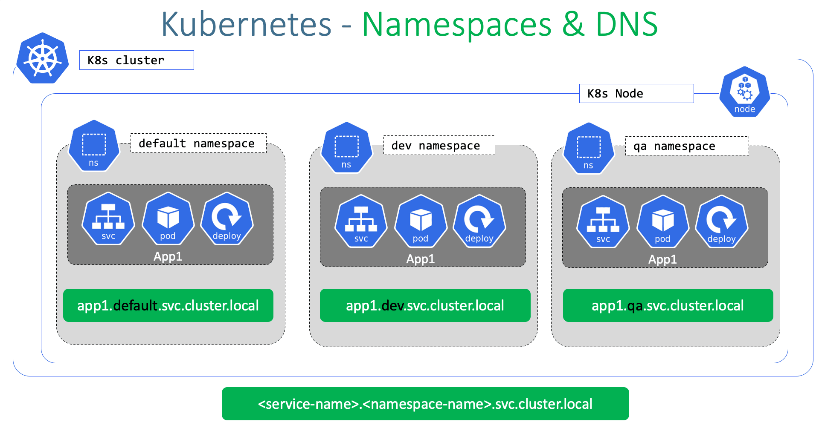
Organizing Pods - Namespaces
Provide scope for object names
Allows to organize complex systems into distinct groups
Not all resources are namespaced
Nodes
Cluster Roles

Slide 21
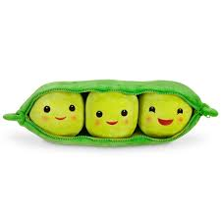
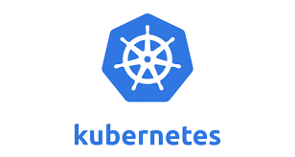
Workshop 1 – Deployment of K8s Pod

Slide 22
Deployment of K8s Pod - Prerequisites
Running K8s cluster – kind
Container image accessible by K8s Nodes

Slide 23
Preparing the cluster
# Deploy EC2 instance
ssh-keygen –f week5
terraform init
terraform apply—auto-approve
# Copy the installation files to the instance
scp -i week5 init_kind.sh kind.yaml 44.196.58.89:/tmp
# Log into the instance
ssh -I week5 <public ip>
# Update permissions
cd /tmp
chmod 777 init_kind.sh
# Run installation script. If the command errors out, exit ssh session, ssh to the instance again and re-run ./init_kind.sh
./init_kind.sh
# Verify the cluster in running
kubectl get nodes

Slide 24
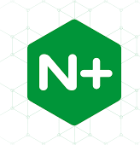
Niginx pod deployment
# Creating nginx pod
$ kubectl run nginx --image nginx
# List all pods in a default namespace
$ kubectl get pods
# List all pods in all namespaces
$ kubectl get pods --all-namespaces
# Retrieve pod's descriptor
$ kubectl get pod nginx -o yaml
# Access nginx web server running in a pod
$ kubectl port-forward nginx 8080:80
$ curl localhost:8080 # Send this command in a new terminal session

Slide 25
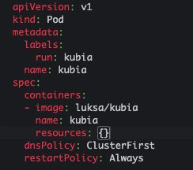
Create pod manifest
# Create a manifest file
$ alias k=kubectl
k run kubia --image luksa/kubia --dry-run -o yaml > kubia-manual.yaml
# Edit the manifest and create the pod
k apply –f kubia-manual.yaml

Slide 26
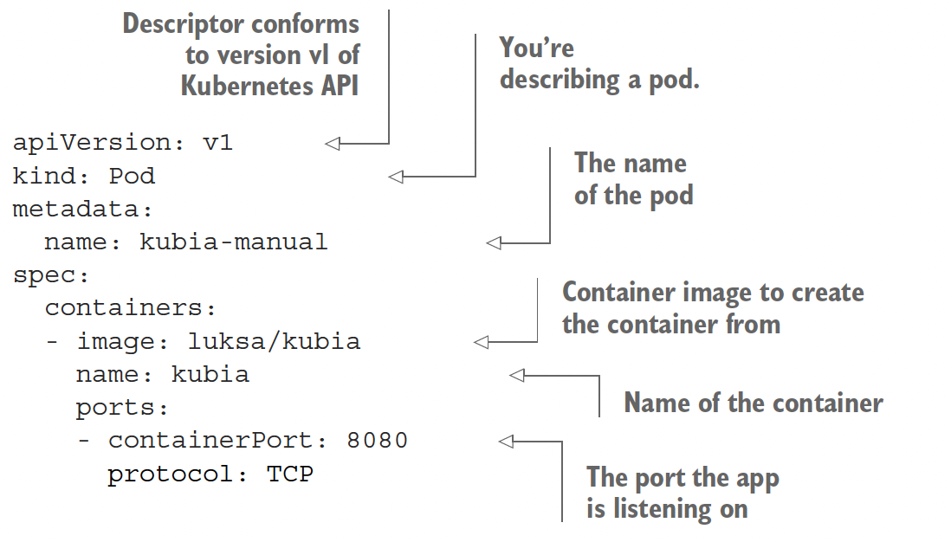
Kubia deployment with YAML manifest
$ kubectl explain pods
$ kubectl explain pod.spec
$ kubectl create -f kubia-manual.yaml
$ kubectl get po kubia-manual -o yaml
$ kubectl logs kubia-manual
$ kubectl logs kubia-manual -c kubia
$ kubectl port-forward kubia-manual 8888:8080
$ curl localhost:8888

Slide 27
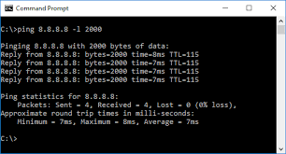
Retrieving logs - Pingpong
# Get logs of the pod. By default, the command will only show the logs of the first container in the pod
$ kubectl run pingpong --image alpine ping 127.0.0.1
$ kubectl logs pingpong
$ kubectl logs pingpong –c pingpong
$ kubectl logs pingpong --tail 1 --follow
# Full definition of the running pod
$ kubectl get po pingpong -o yaml

Slide 28
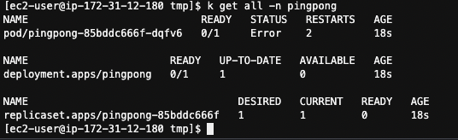
Can we scale the pod? Deployments => ReplicaSets => Pods
# Let's try scaling the pod
$ kubectl scale pod pingpong --replicas=3
# Let's create a deployment of the pingpong in it's own namespace
alias k=kubectl
k create ns pingpong
kubectl create deployment pingpong --image=alpine:3.14 -n pingpong -- ping 127.0.0.1
kubectl get all –n pingpong

Slide 29
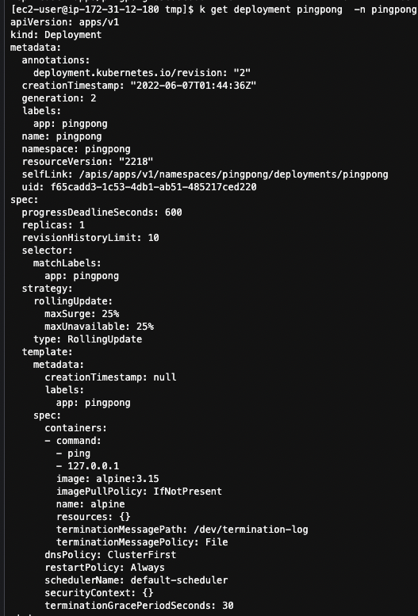
Descriptor: Deployment
Responsible for multiple versions of application (replicasets)
Defines the way to perform rolling forward and rollback updates
Does it by using ReplicaSets
k get deployment pingpong -n pingpong -o yaml

Slide 30
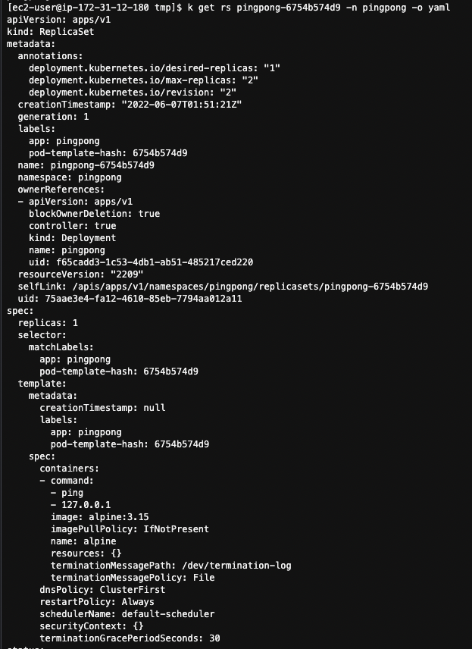
Descriptor: ReplicaSet

Slide 31
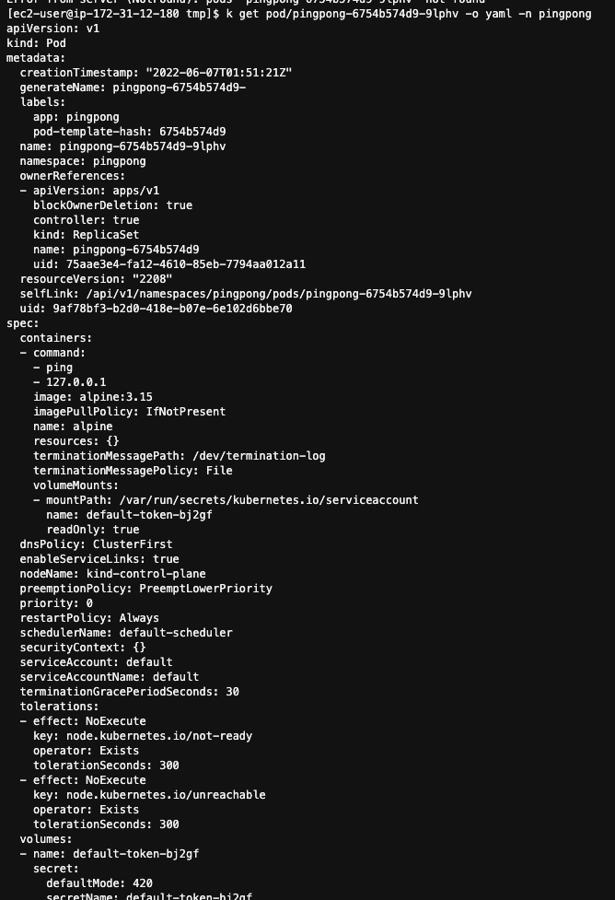
Descriptor: Pod

Slide 32
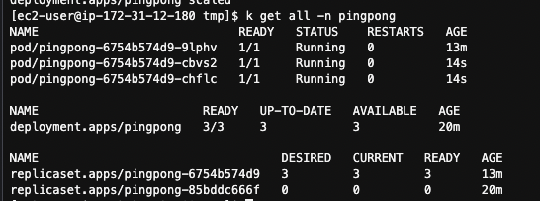
Scaling
k scale deployment pingpong --replicas 3 -n pingpong
k scale deployment pingpong --replicas 1 -n pingpong

Slide 33
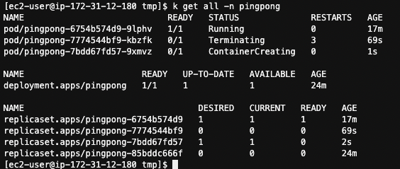
Rolling out a new version – Updating alpine version to 3.15

Slide 34

Maintaining the desired state - Resilience
watch kubectl get pods
kubectl delete pod pingpong-xxxxxxxxxx-yyyyy
As soon as the pod is in "Terminating" state, the Replica Set replaces it
What will happen if we terminate the "stand-alone" pod?

Slide 35

Workshop 1 – The End

